Slide 1
Sentiment Analysis Text Data (COVID-19 Tweets)
Data science Capstone Project
ICT Upskilling Training
Powered By: Mohammad Saleh

Slide 2
Brief
This project addresses the problem of analyzing feelings on Twitter. The goal of this project was to predict the emotions of this specific Twitter dataset using Python.
This data I got from the site Kaggle, and related to the tweets of Twitter users who used hashtags related to the Corona virus.
The biggest benefit of this analysis is knowing people's opinions about the virus and analyzing texts to find out their reactions and classify them as positive, negative or neutral

Slide 3
Problems
How can we know if the tweet is positive, negative or neutral because the data will not give us the sentiment for each text.
Can we know how many people their tweets are negative, positive or neutral based on the texts?
What is the best algorithm that can be applied to extract the best possible result from these texts?

Slide 4
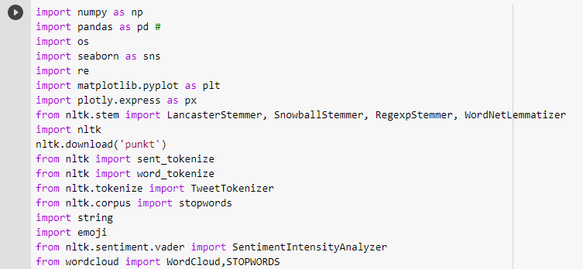
Solutions
Download the important libraries and Use a natural language toolkit like NLTK.

Slide 5
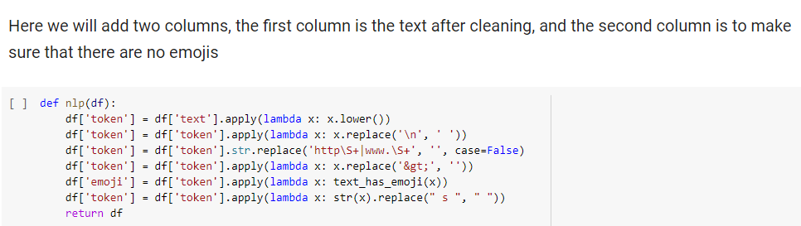
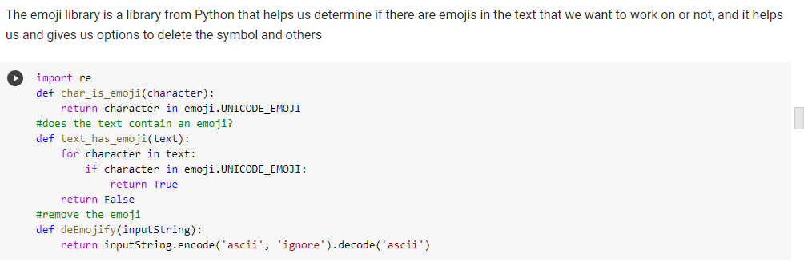
Count.
Use regular expression to clean up the text and remove emoji

Slide 6
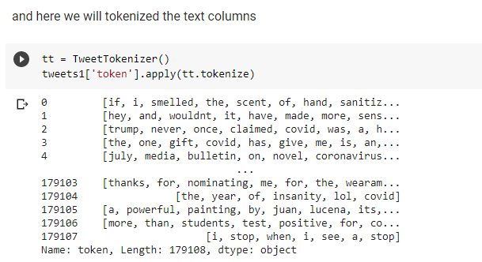
Count.
Tokenization

Slide 7
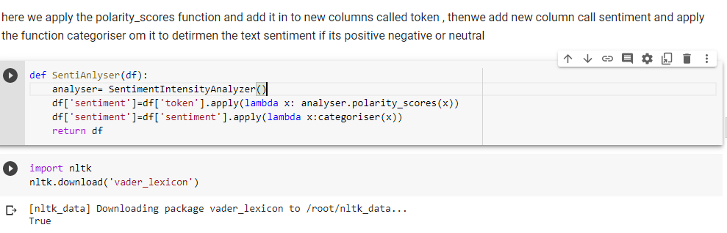
Count.
Polarity score function

Slide 8
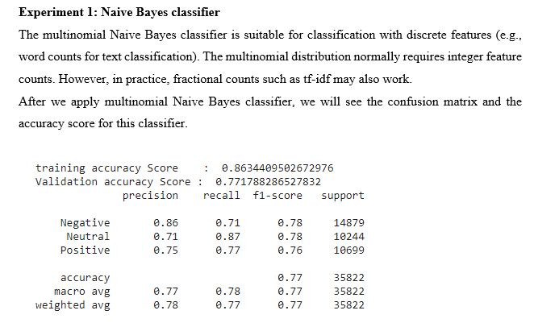
Count.
Classification

Slide 9
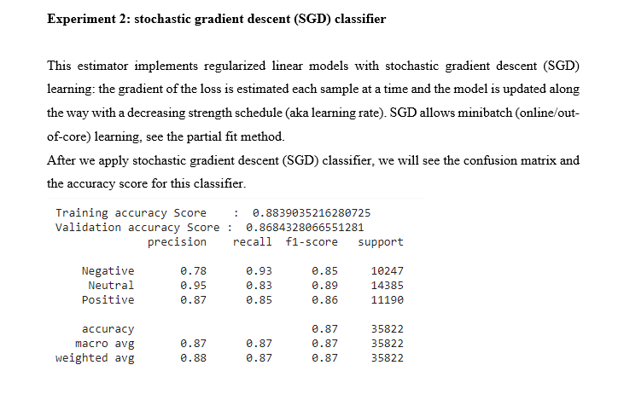
Count.
Classification

Slide 10
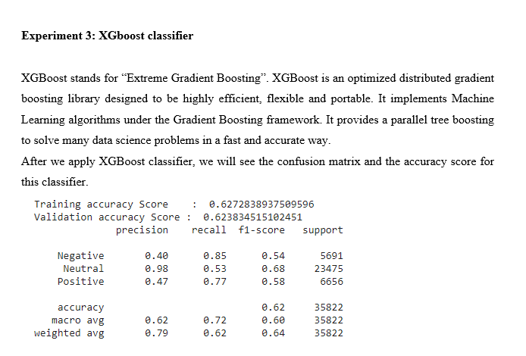
Count.
Classification

Slide 11
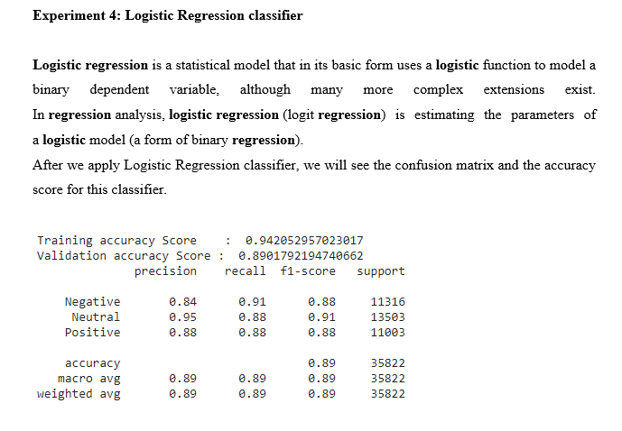
Count.
Classification

Slide 12
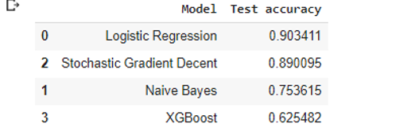
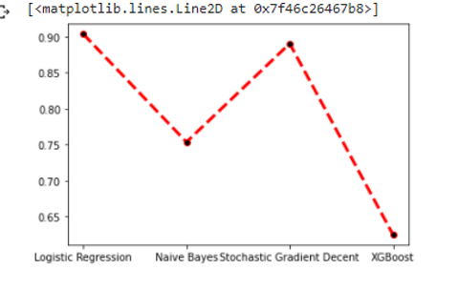
conclusion
The logistic regression classifier is the gave us the best accuracy

